Slide 1

Quick Term Template: Class addition by design patterns Full tutorial available at: http://obi-ontology.org/page/Quick_Term_Templates
Philippe Rocca-Serra
proccaserra@gmail.com
http://www.isa-tools.org
Carlo Torniai
torniai@ohsu.edu
OBI consortium

Slide 2
Background
Problem:
How to enable knowledge experts to add large number of classes with as little hassle as possible?
Batch processing capability
Automatic class axiomization
Identification of recurring patterns in knowledge representation

Slide 3
Tools & Prerequisites
Protégé 3.4.4
Mapping Master Plugin (O’Connor et al, 2010)
[http://protege.cim3.net/cgi-bin/wiki.pl?MappingMaster]
An OWL Ontology
Knowledge of OWL Manchester Syntax
A use case, a pattern/formal representation!

Slide 4
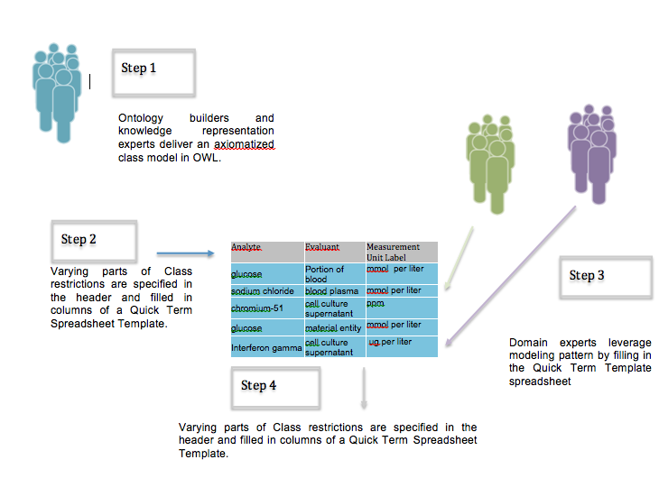
QTT approach overview
Processing the Spreadsheet with Mapping Master

Slide 5
Principle: 1. Finding a pattern
Measuring concentration of glucose in urine
Measuring concentration of calcium in plasma
Measuring concentration of CO2 in air
Measuring concentration of PSA in plasma
…….

Slide 6
Principle: 2.modeling step
Measuring concentration of glucose in urine
Measuring concentration of calcium in plasma
Measuring concentration of CO2 in air
Measuring concentration of PSA in plasma
<data> <quality> <evaluant> <analyte>

Slide 7
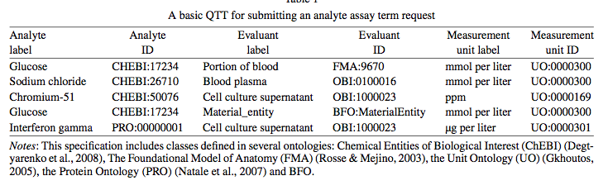
QTT example
Target Ontology: OBI.owl
Constraints:
Map terms (or submit if not available) to compatible ontologies (i.e. sharing the same top level ontology, here BFO 1.1)
Import those terms External.owl + ExternalDerived.owl files

Slide 8
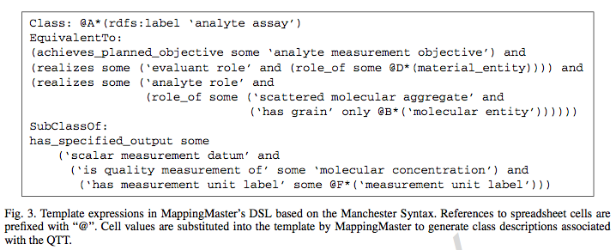
Principle: 3. Class Definition and formalization

Slide 9
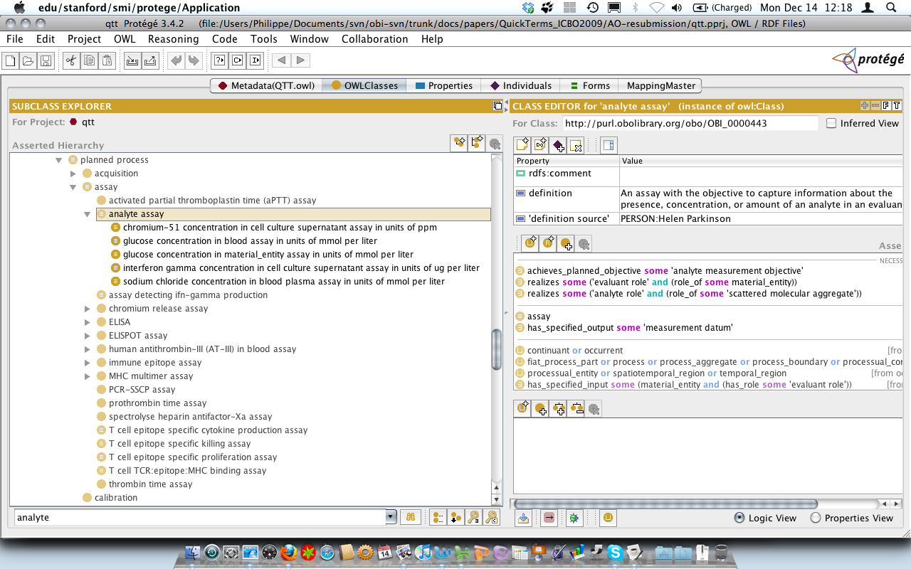
Principle: 4.Process with Mapping Master

Slide 10
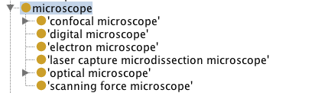
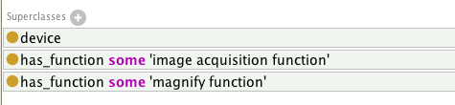
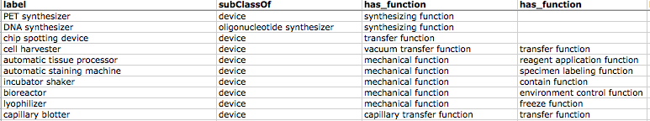
Device example
Class: @A*(rdfs:label)
SubClassOf: @B*(rdfs:label),
has_function some @C*(rdfs:label),
has_function some @D*(rdfs:label),
Notes:
Part per million
Mmol per liter : mole per liter

Slide 11
Future Work
Automatic Import via MIREOT mechanism of external and externalDerived.owl files (or equivalent structure) in target ontology during QTT processing
Creation of a library of QTT available from OBI
Analyte template
Service template
Instrument template
Single nucleotide mapping structure assay
More if people willing to share!

Slide 12
Reference / Acknowledgements
Overcoming the Ontology Enrichment Bottleneck with Quick Term Templates
P. Rocca-Serra, A. Ruttenberg, M. J. O'Connor, T. Whetzel, D. Schober, J. Greenbaum, M. Courtot, S. A. Sansone, R. Scheurmann, B. Peters ( & OBI consortium)
Journal of Applied Ontology, 6, 13-22. Published in 2011
TUTORIAL:
http://obi-ontology.org/w/images/d/dd/Howto-QTT-Template-Import-MappingMaster.doc

